Slide 1
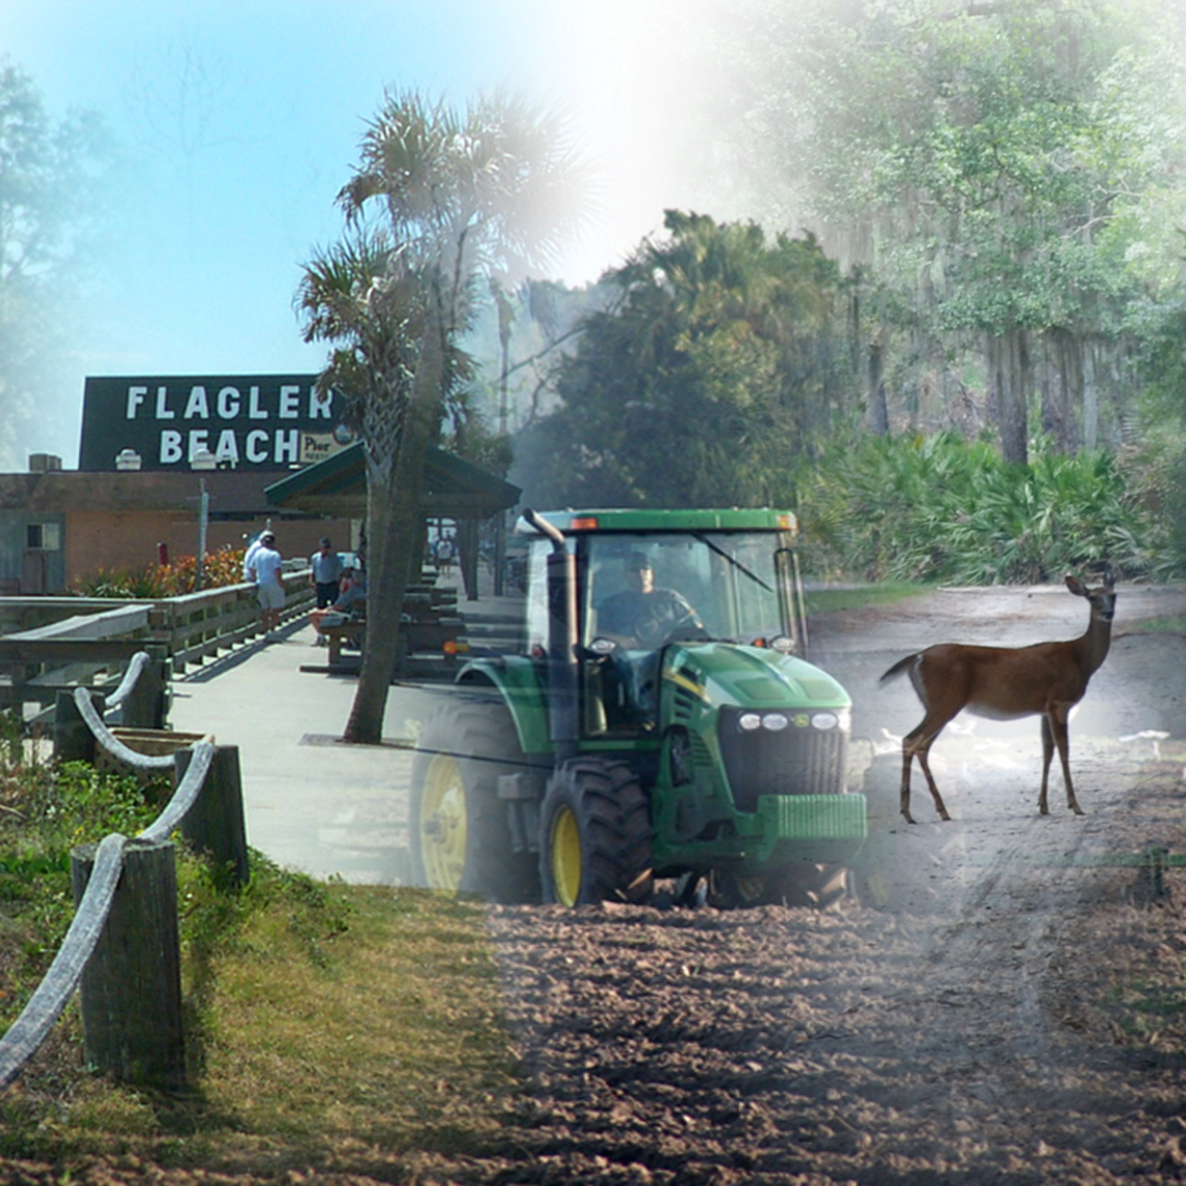
St. Johns River-to-Sea Loop Trail Summit
Welcome to
Flagler County, Florida

Slide 2
St. Johns River-to-Sea Loop Trail Summit
Flagler County Segment

Slide 3
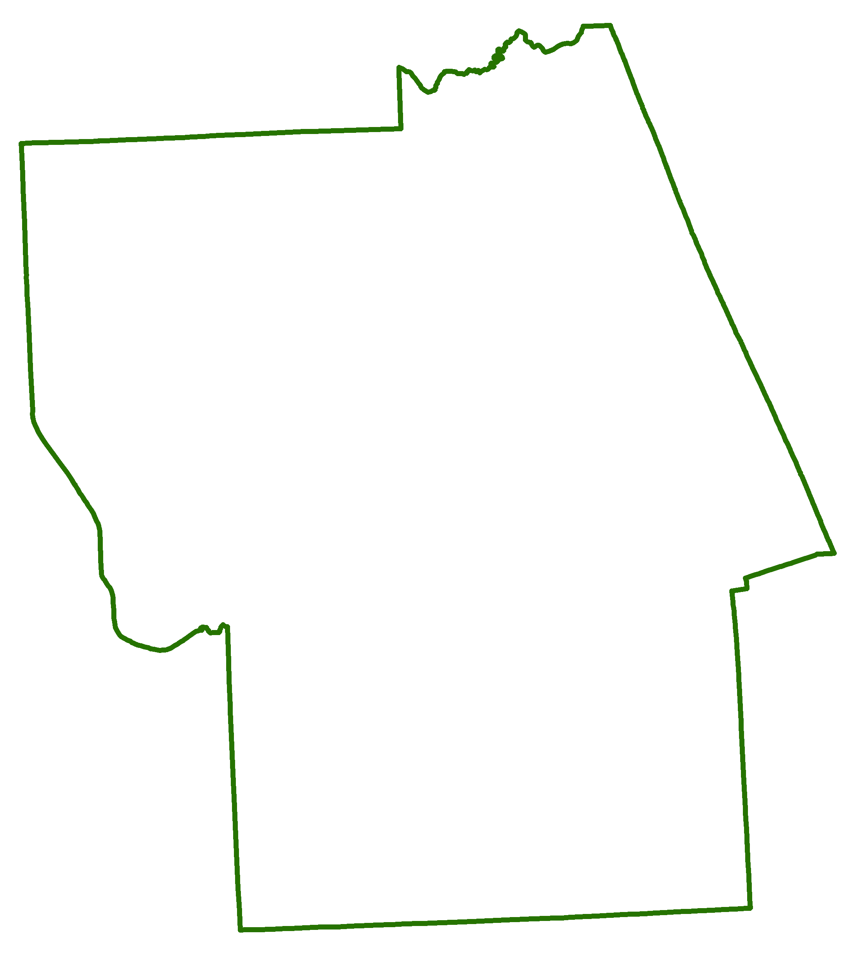
St. Johns River-to-Sea Loop Trail Summit
Flagler Segment

Slide 4
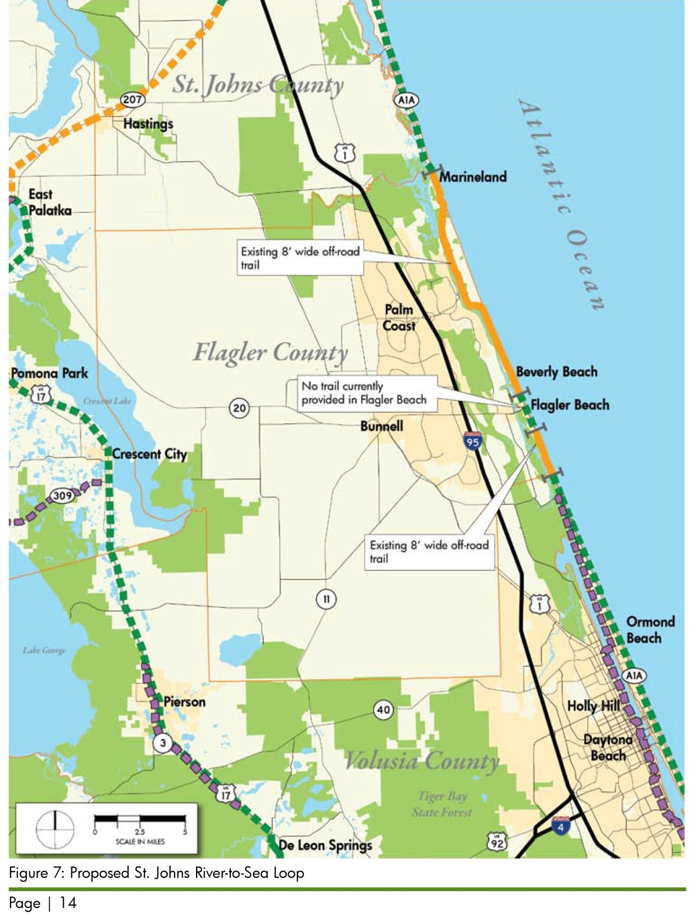
St. Johns River-to-Sea Loop Trail Summit

Slide 5
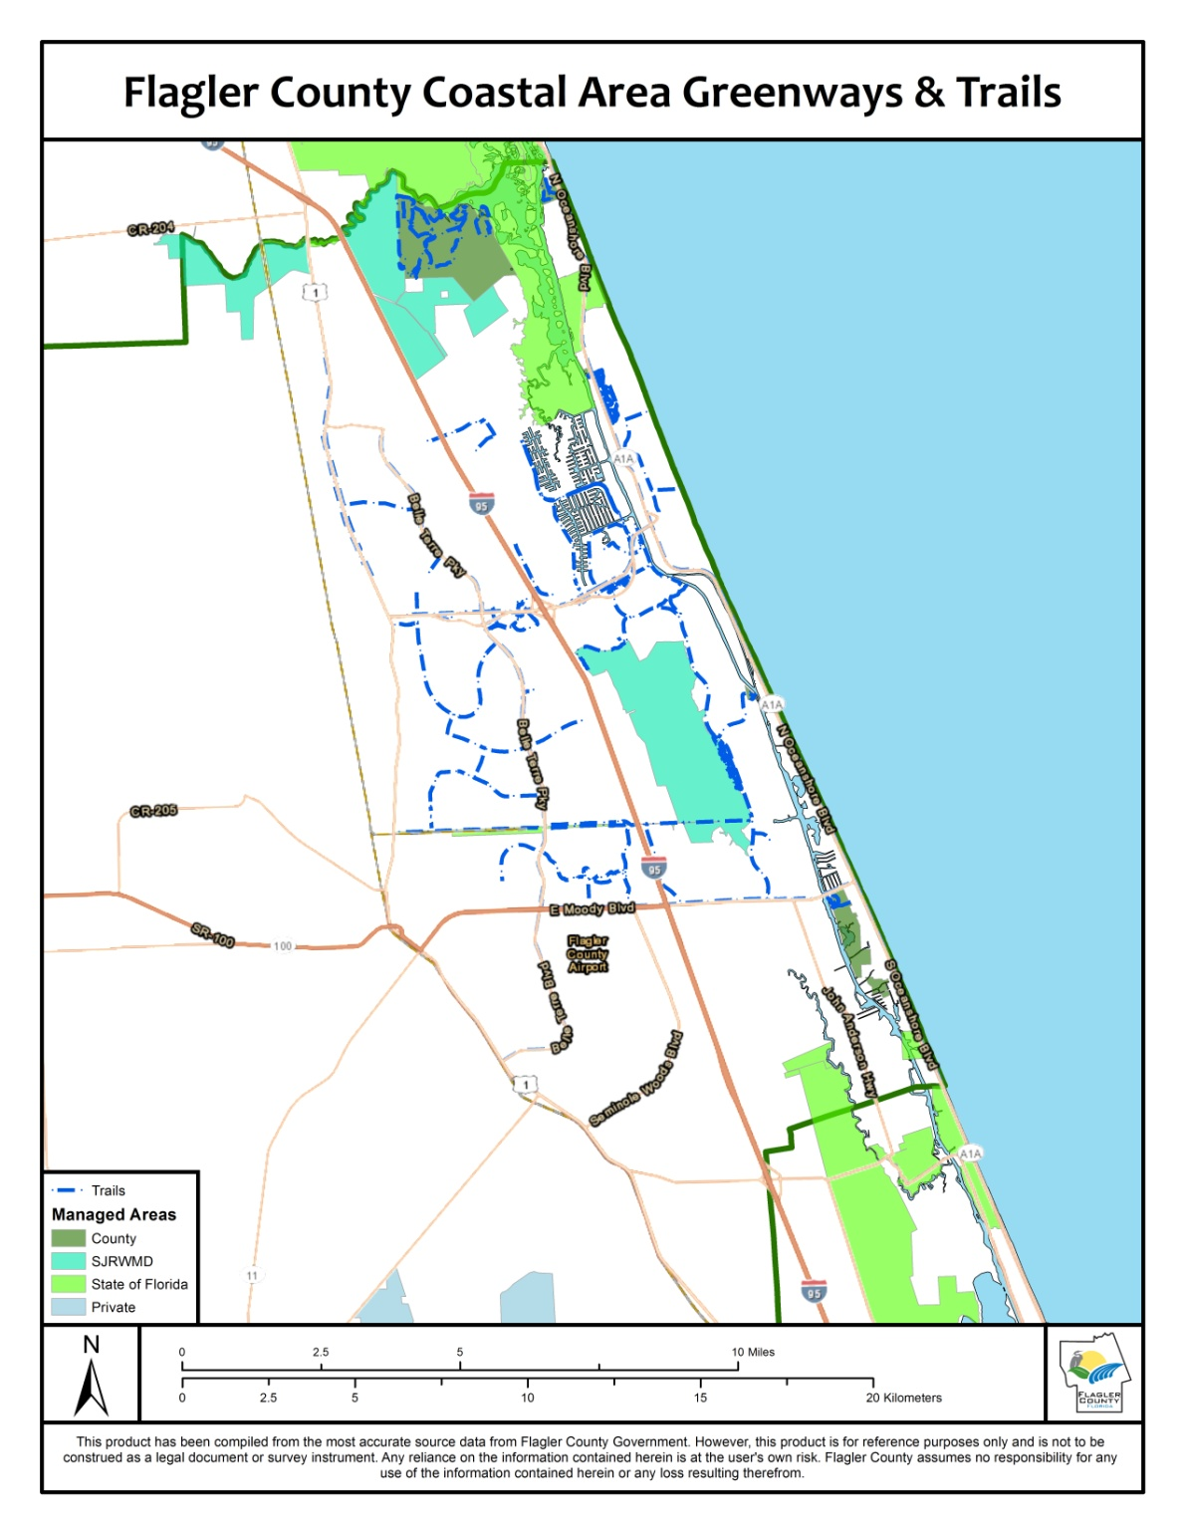
St. Johns River-to-Sea Loop Trail Summit

Slide 6
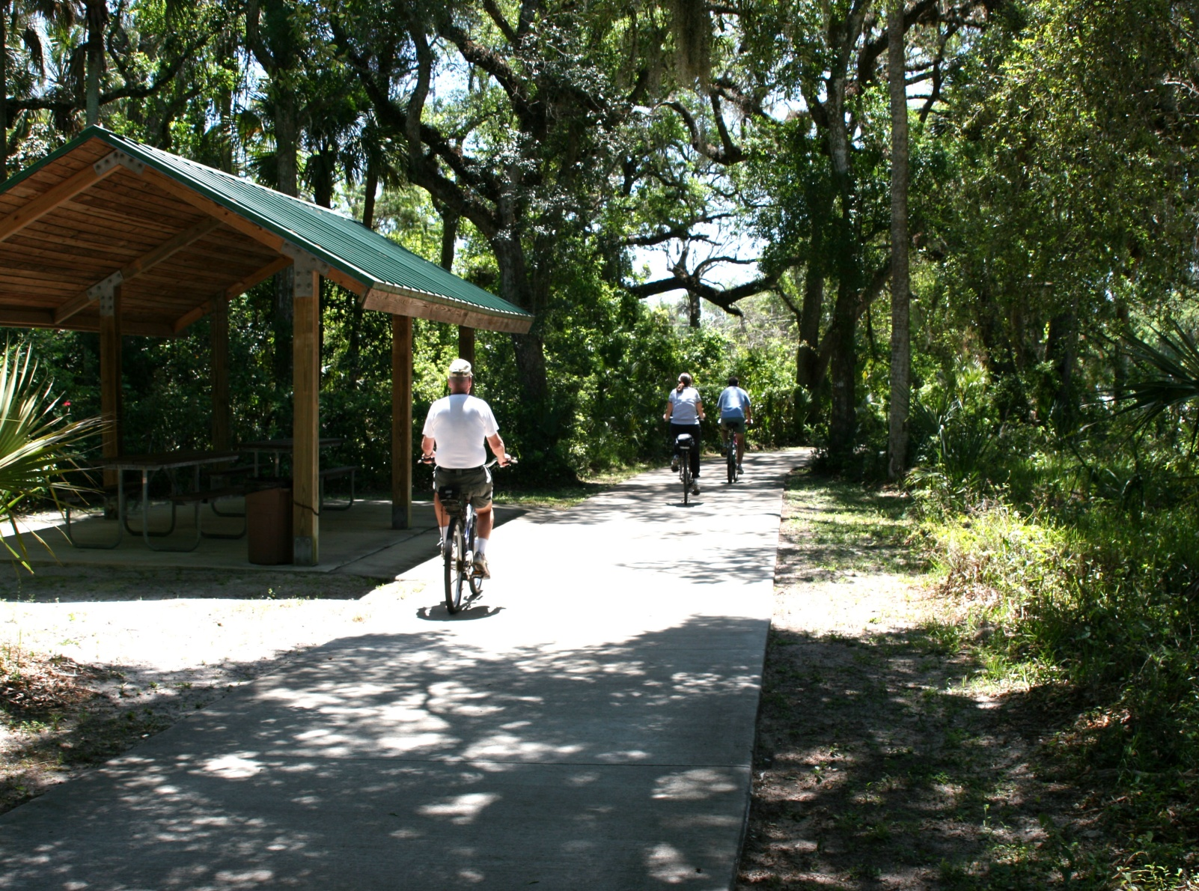
St. Johns River-to-Sea Loop Trail Summit
“Hammock” area – typical 8’ segment with picnic shelters along route

Slide 7
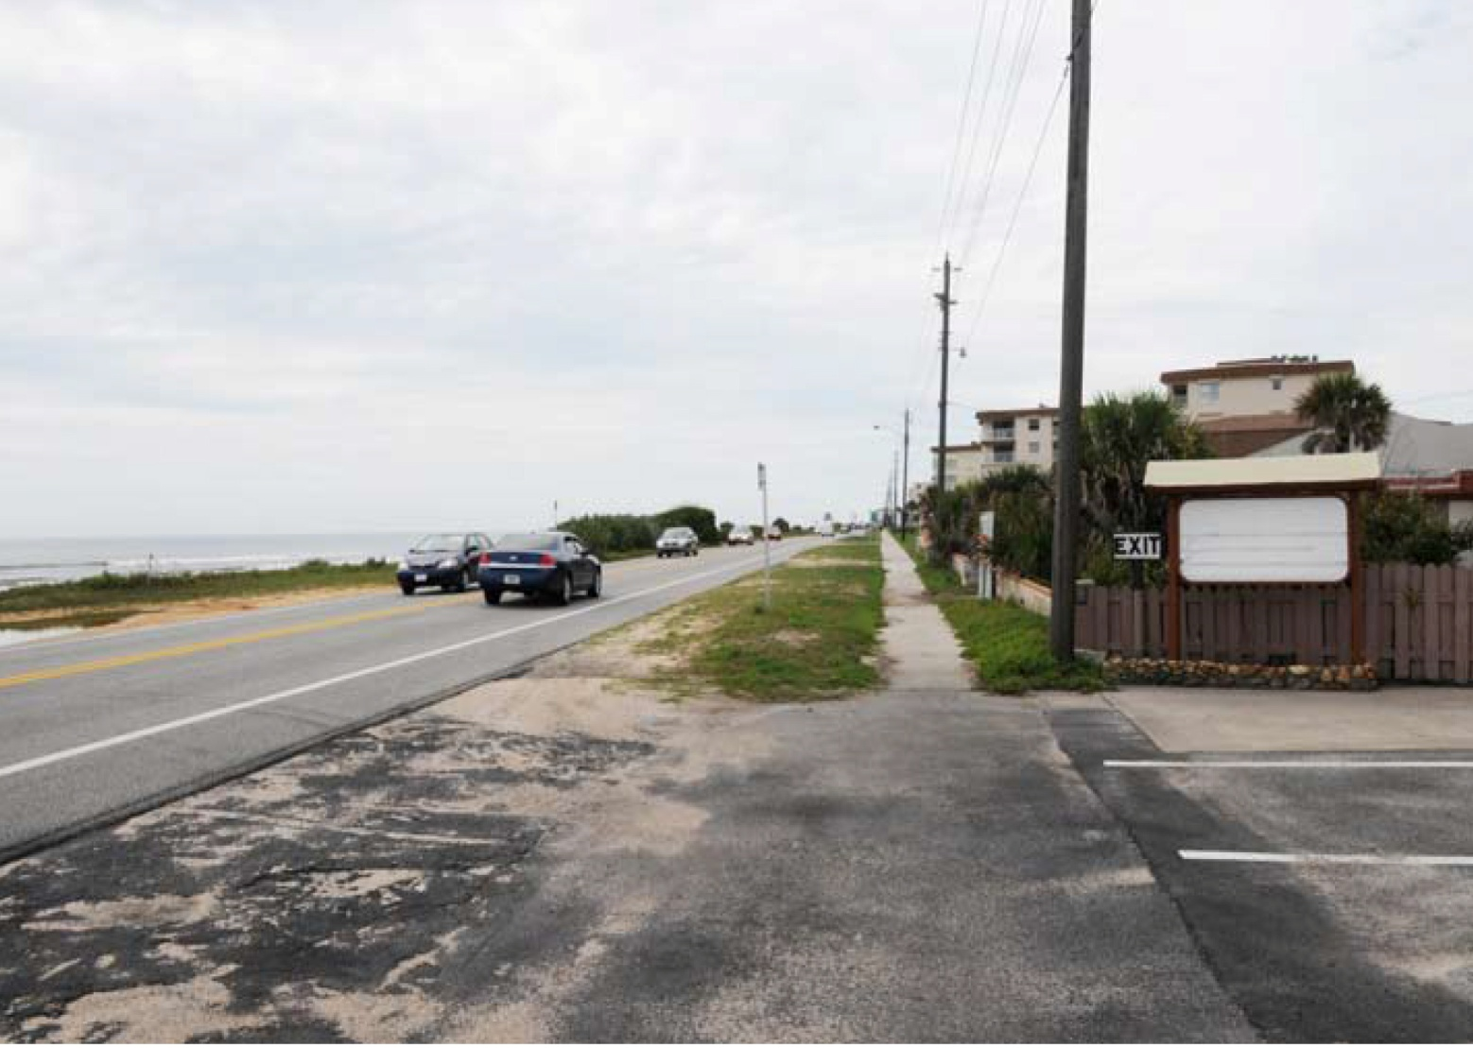
St. Johns River-to-Sea Loop Trail Summit
Downtown Flagler Beach area – narrower sidewalk, lots of street intersections

Slide 8
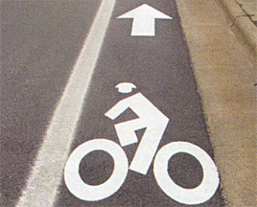
St. Johns River-to-Sea Loop Trail Summit
Addressing the “Gap” in Flagler Beach
Bike Lanes
Boardwalk/Promenade

